Slide 1

Data Visualization Charts
Sai Ramana YR

Slide 2
Types of Charts
Comparison Charts
Composition Charts
Distribution Charts
Analyzing Trend Charts
Relationship Charts

Slide 3
Comparsion Charts
Charts are perfect for comparing one or many value sets, and they can easily show the low and high values in the data sets.
Column Chart
Bar Chart
Pie Chart
Line Graph
Scatter Plot
Mekko chart or Table trees
Bullet Graph

Slide 4
Composition Charts
We use this type of chart to show how individual parts make up the whole of something.
Pie
Stacked Bar
Stacked Column
Area
Waterfall
Mekko or Tables

Slide 5
Distribution Charts
Distribution charts help you to understand outliers, the normal tendency, and the range of information in your values.
Scatter Plot
Line
Column
Bar
Mekko

Slide 6
Analyzing Charts
If you want to know more information about how a data set performed during a specific time period, there are specific chart types that do extremely well.
Dual Line Axis
Line
Column

Slide 7
Relationship Charts
Relationship charts are suited to showing how one variable relates to one or numerous different variables. You could use this to show how something positively effects, has no effect, or negatively effects another variable.
Scatter
Bubble
Line

Slide 8
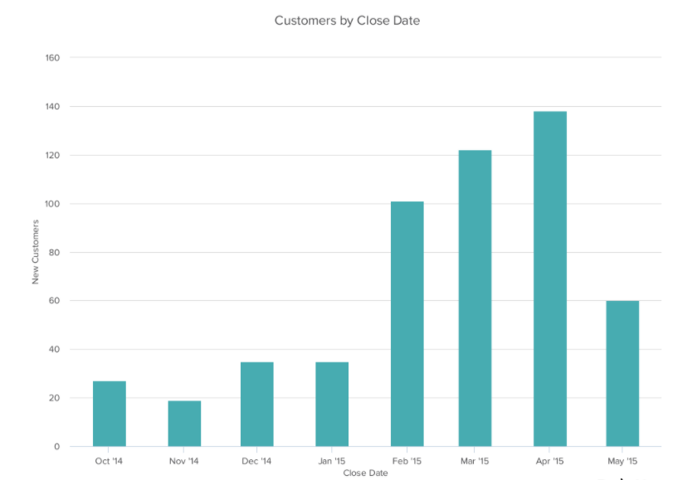
Column Chart
A column chart is used to show a comparison, Distribution and Analyzing among different items, or it can show a comparison of items over time. You could use this format to see the revenue per landing page or customers by close date.

Slide 9
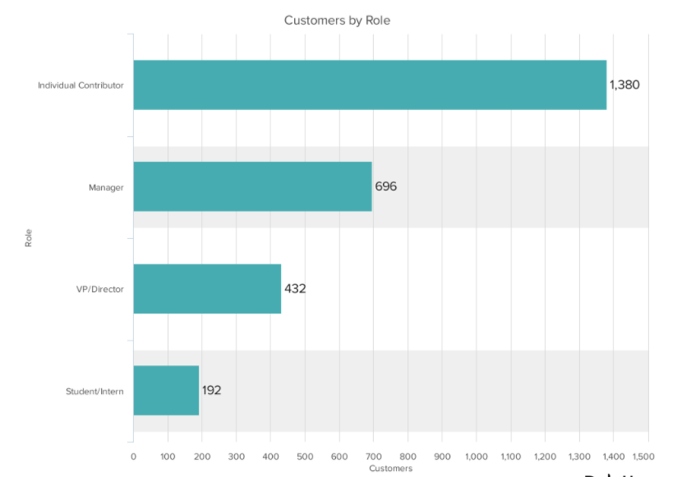
Bar Chart
A bar graph, basically a horizontal column chart, should be used to avoid clutter when one data label is long or if you have more than 10 items to compare. This type of visualization can also be used to display negative numbers and Distribution of Data.

Slide 10
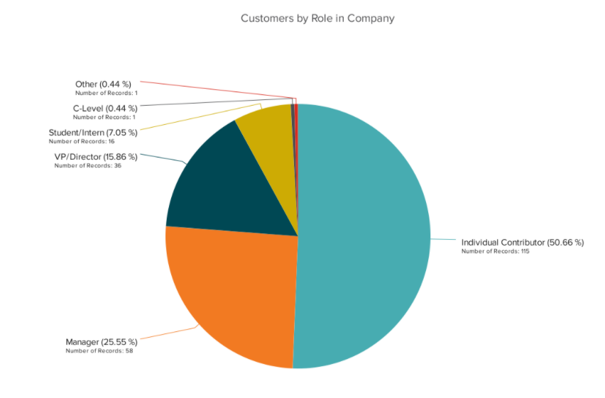
Pie Chart
A pie chart shows a static number and how categories represent part of a whole -- the composition of something. A pie chart represents numbers in percentages, and the total sum of all segments needs to equal 100%.
Pie Chart is also used in Composition of Data.

Slide 11
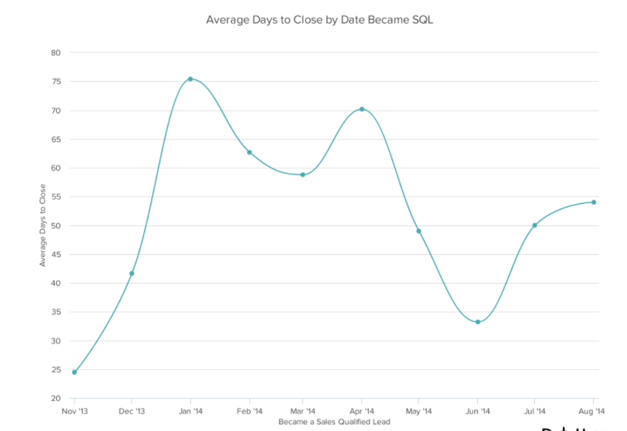
Line Graph
A line graph reveals trends or progress over time and can be used to show many different categories of data. You should use it when you chart a continuous data set and Discrete Data
It is also used for Comparison, Distribution of Data and also for determining Realtionships.

Slide 12
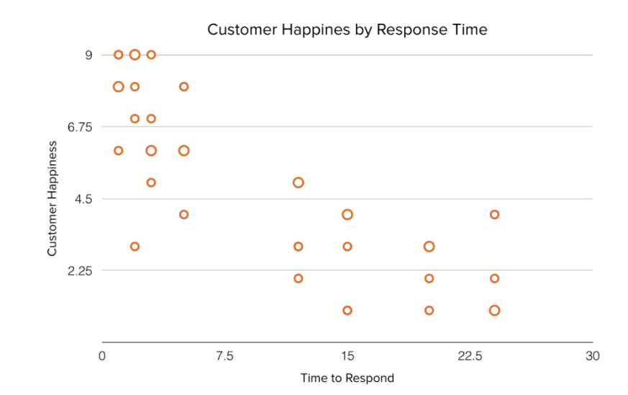
Scatter Plot
A scatter plot or scattergram chart will show the relationship between two different variables or it can reveal the distribution trends. It should be used when there are many different data points, and you want to highlight similarities in the data set. This is useful when looking for outliers or for understanding the distribution of your data.

Slide 13
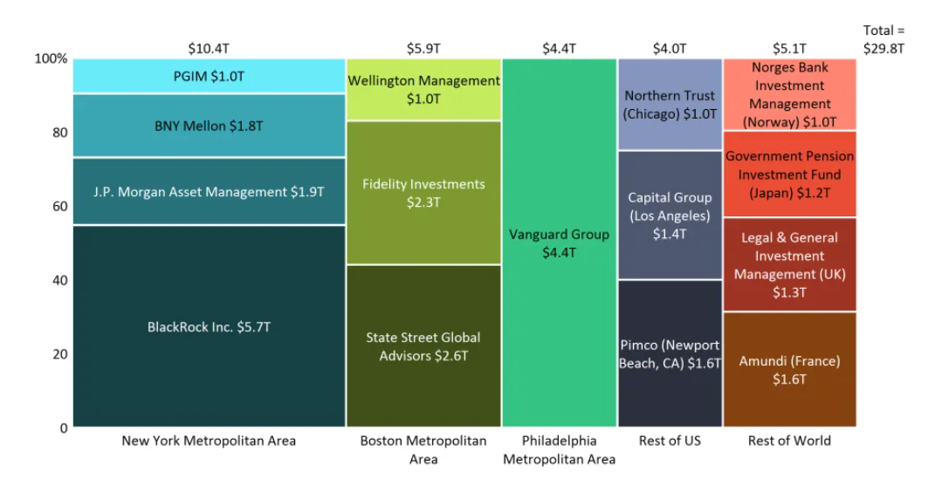
Mekko or Tables or TreeGraph
Also known as a marimekko chart, this type of graph can compare values, measure each one's composition, and show how your data is distributed across each one.
It's similar to a stacked bar, except the mekko’s x-axis is used to capture another dimension of your values -- rather than time progression, like column charts often do. In the graphic below, the x-axis compares each city to one another.

Slide 14
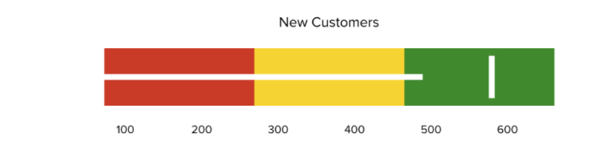
Bullet Graph
A bullet graph reveals progress toward a goal, compares this to another measure, and provides context in the form of a rating or performance.

Slide 15
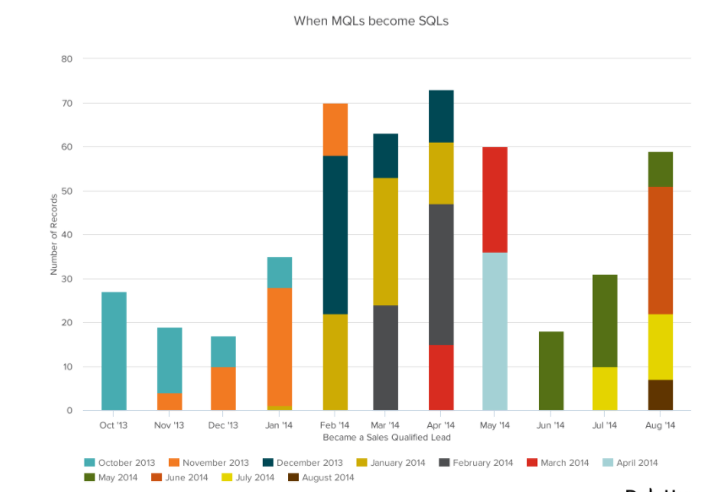
Stacked Bar
This should be used to compare many different items and show the composition of each item being compared.

Slide 16
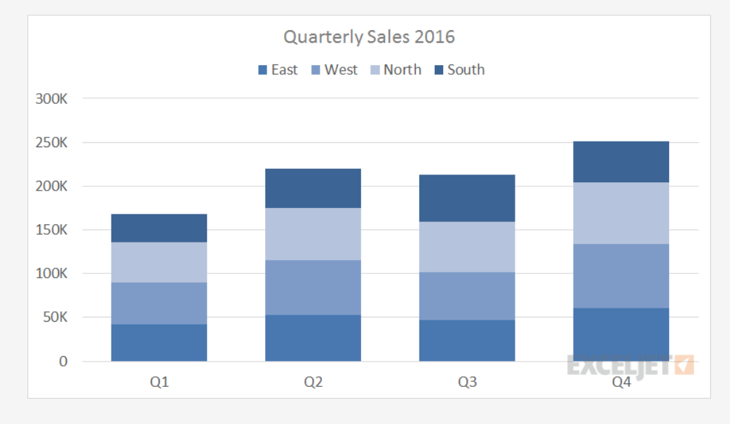
Stacked Column
A stacked column chart is a basic Excel chart type to allow part-to-whole comparisons over time, or across categories. In a stacked column chart, data series are stacked one on top of the other in vertical columns.
Stacked column charts can show change over time because it's easy to compare total column lengths. However, except for the first series of data (next to the x-axis) and total bar length, it's difficult to compare the relative size of the components that make up each bar. As categories or data series are added, stacked column charts quickly become complicated.

Slide 17
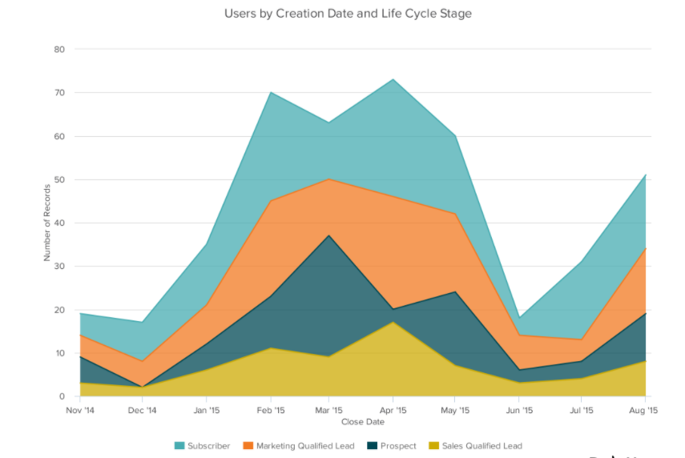
Area Graph
An area chart is basically a line chart, but the space between the x-axis and the line is filled with a color or pattern. It is useful for showing part-to-whole relations, such as showing individual sales reps' contribution to total sales for a year. It helps you analyze both overall and individual trend information.

Slide 18
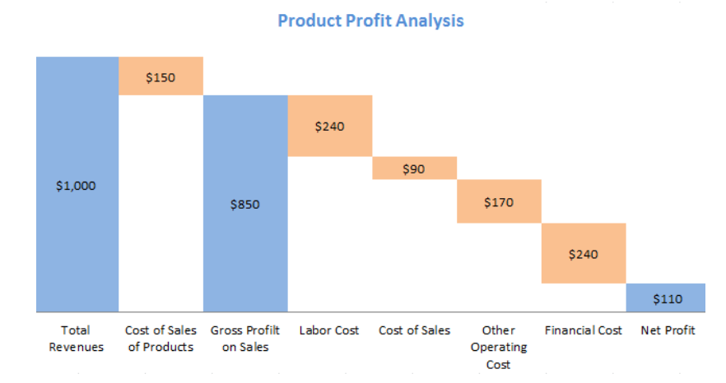
WaterFlow
A waterfall chart should be used to show how an initial value is affected by intermediate values -- either positive or negative -- and resulted in a final value. This should be used to reveal the composition of a number. An example of this would be to showcase how overall company revenue is influenced by different departments and leads to a specific profit number.

Slide 19
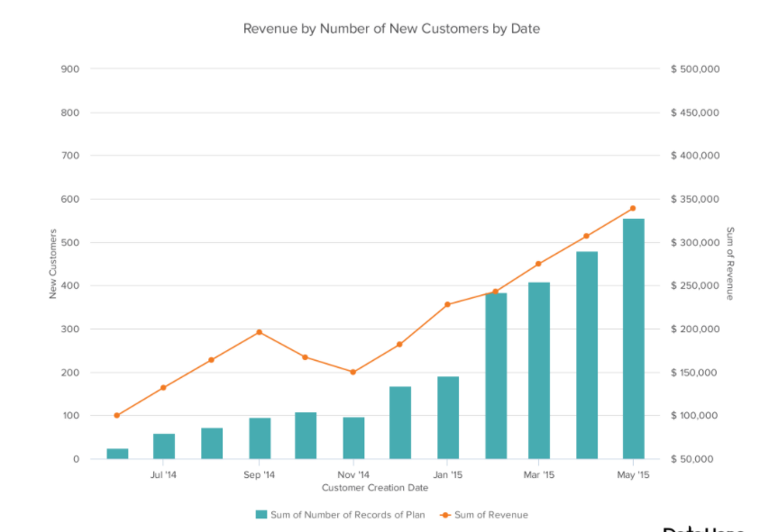
Dual-Axis Line Graph
A dual axis chart allows you to plot data using two y-axes and a shared x-axis. It's used with three data sets, one of which is based on a continuous set of data and another which is better suited to being grouped by category. This should be used to visualize a correlation or the lack thereof between these three data sets.

Slide 20
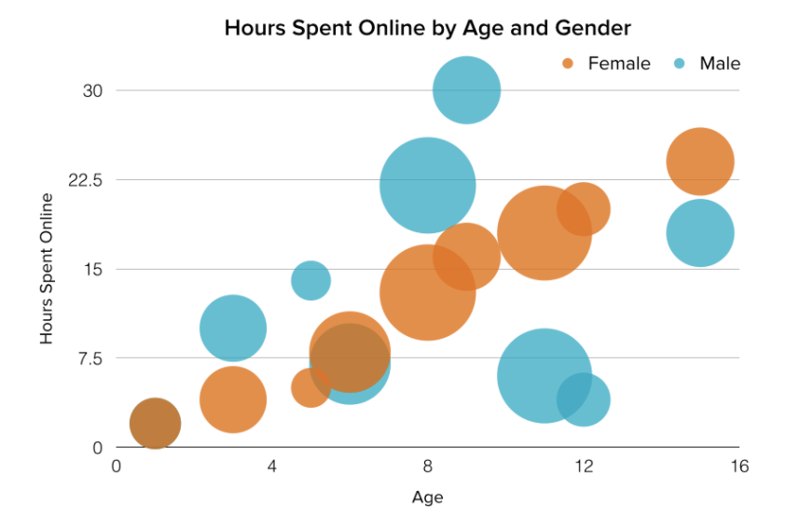
Bubble Graph
A bubble chart is similar to a scatter plot in that it can show distribution or relationship. There is a third data set, which is indicated by the size of the bubble or circle.

Slide 21
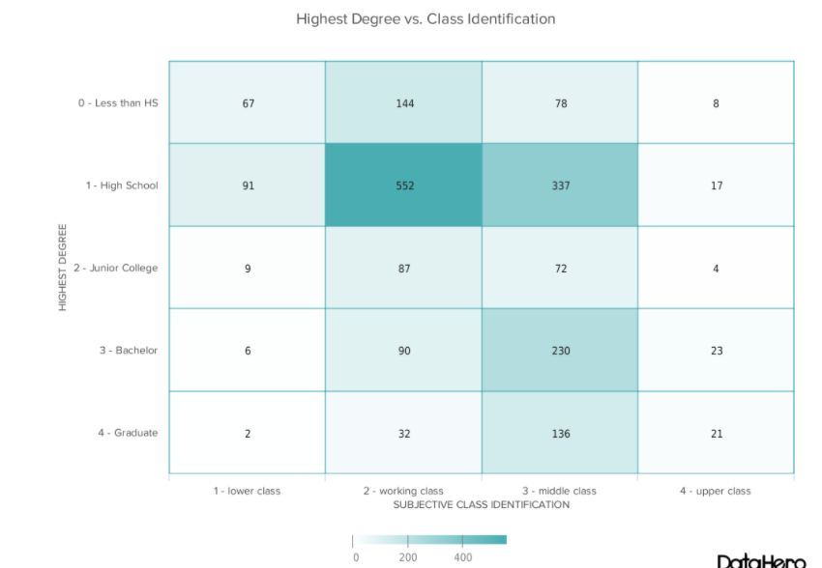
Heat Map
A heat map shows the relationship between two items and provides rating information, such as high to low or poor to excellent. The rating information is displayed using varying colors or saturation.

Slide 22
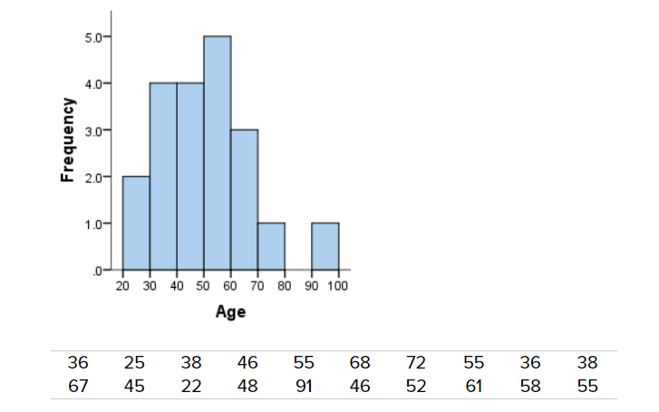
Histogram
A histogram is a plot that lets you discover, and show, the underlying frequency distribution (shape) of a set of continuous data. This allows the inspection of the data for its underlying distribution (e.g., normal distribution), outliers, skewness, etc. An example of a histogram, and the raw data it was constructed from

Slide 23
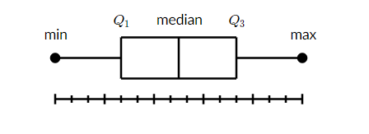
Box and Whisker-Plot
A box and whisker plot—also called a box plot—displays the five-number summary of a set of data. The five-number summary is the minimum, first quartile, median, third quartile, and maximum.
In a box plot, we draw a box from the first quartile to the third quartile. A vertical line goes through the box at the median. The whiskers go from each quartile to the minimum or maximum.

Slide 24
Bibliography
https://blog.hubspot.com/marketing/types-of-graphs-for-data-visualization
https://www.mekkographics.com/product/power-of-mekko-charts/
https://exceljet.net/chart-type/stacked-column-chart#:~:text=A%20stacked%20column%20chart%20is,to%20compare%20total%20column%20lengths.
https://statistics.laerd.com/statistical-guides/understanding-histograms.php
https://www.khanacademy.org/math/statistics-probability/summarizing-quantitative-data/box-whisker-plots/a/box-plot-review

Slide 25


